Slide 1
ArchSearch.
App Developed by Shaktiman

Slide 2
Index
Background Story
Problem
Solution
Technical Aspects
Snippets of the APP
Conclusion

Slide 3
Background Story
In these difficult days of the ‘Corona Pandemic’ the whole world is hugely affected by the ongoing state which has affected both the mental and physical mindsets of the general population. There has been panic all among the people in the nation especially after the sudden 21-day lockdown announced by the Government.

Slide 4
Understanding the problems
01
Amid this crisis, large gatherings and stampedes at grocery stores totally defy the purpose of this lockdown.
02
Social distancing is key to staying safe and crowding at general stores exposes the people to this virus. This rush for daily supplies could result in further spread of the pandemic.
03
The problem is to prevent crowds while maintaining regular supply to all.

Slide 5
Solution
We have decided to create a user interface in the form of a website/mobile application ‘ArchSearch’ to fulfill the demands of the public while ensuring their safety. This can be used by any user to:
Book slots for grocery shopping
Keep track of stocks in nearby stores
Book home deliveries only for veterans
Keep track of no. of persons in the respective stores at the moment
Generate passes to approach the stores hassle-free.

Slide 6


Technical Aspects
Our project involves extensive work done over various programming languages and frameworks.
The front-end of ArchSearch has been developed on Android Studio with the use of Dart and Flutter. Connecting these visual aspects with the back-end has been accomplished by the use of Javascript and Node.js.
Our mobile application inculcates expertise in these areas of development.

Slide 7
Cycle Diagram
04
User login
Slot Booking
User selects and books a time slot of his/her preference.
User signs up and logs into the app.
01
03
Nearby Stores
Store Details
User gets to select from the list of stores near him/her.
User gets access to availability of items in the store, and slot booking.
02

Slide 8
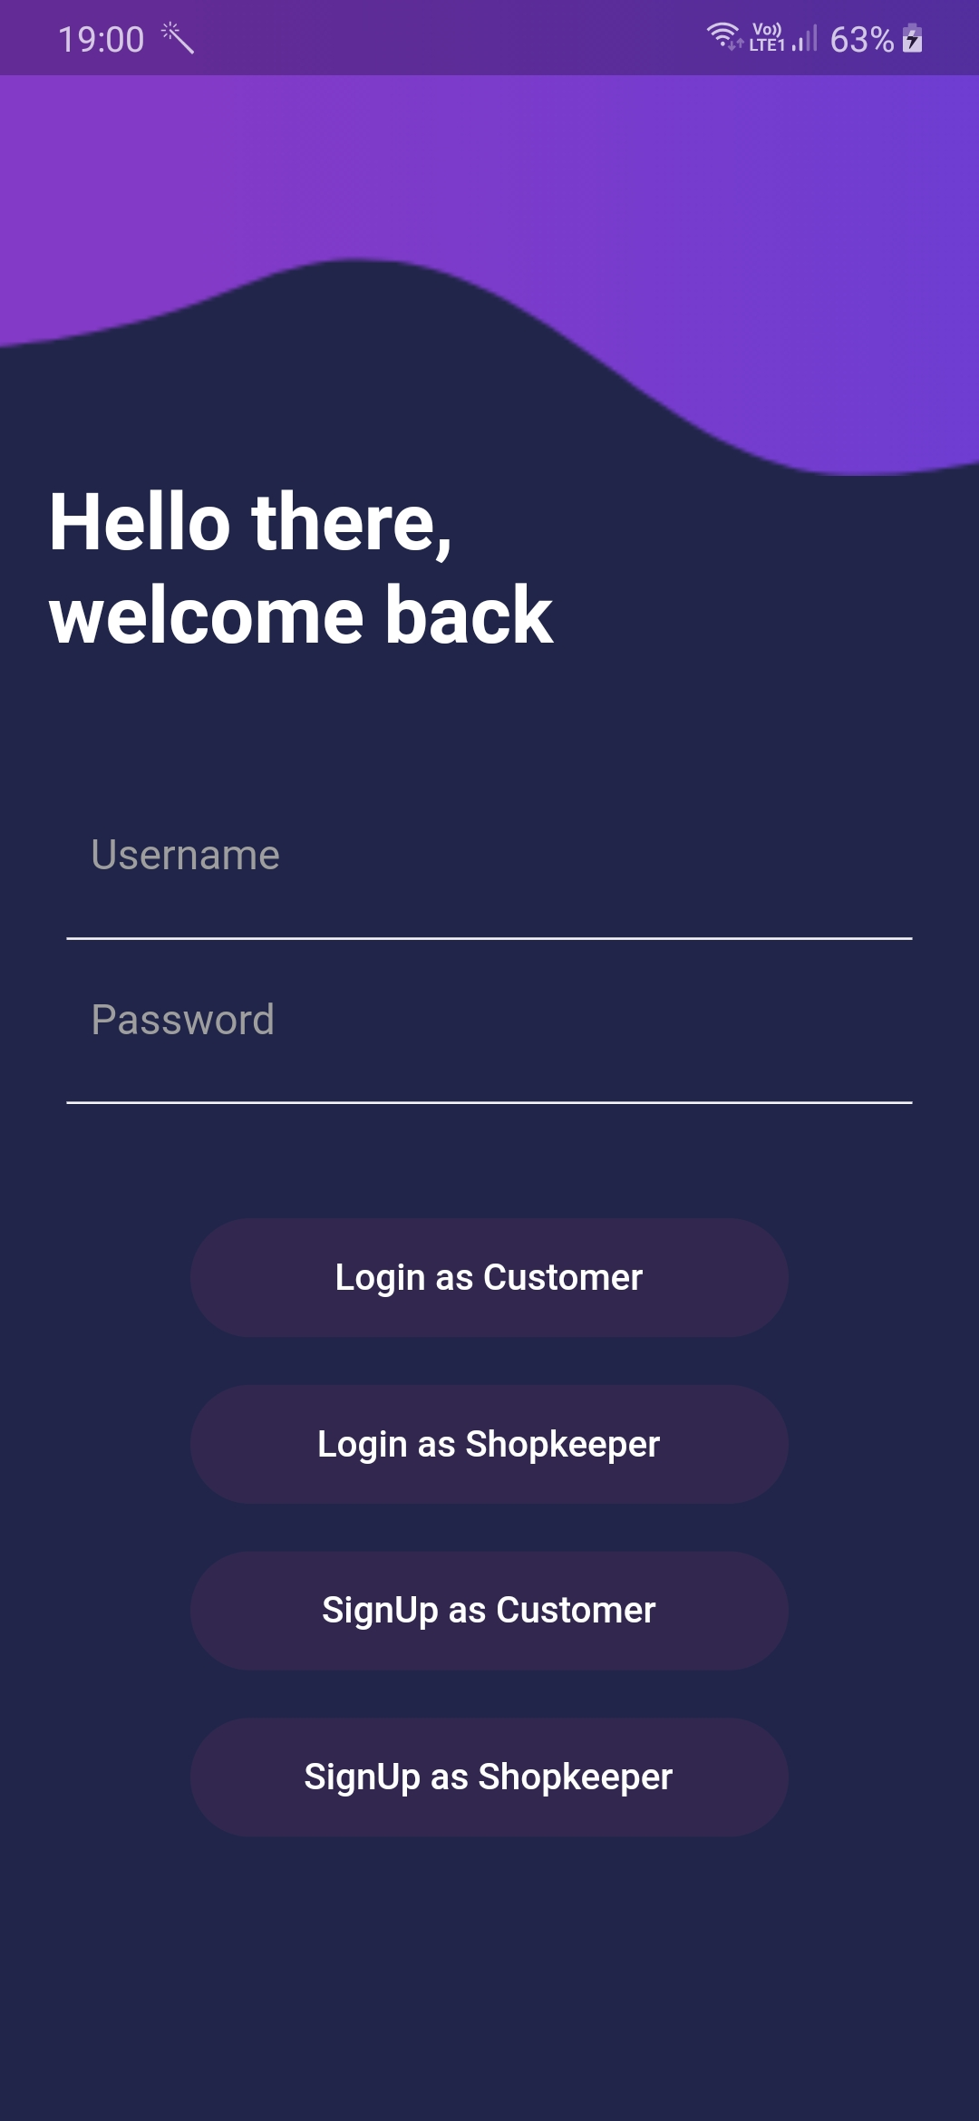
Welcome Page
Both the customer and the shopkeeper can login from the home interface.

Slide 9
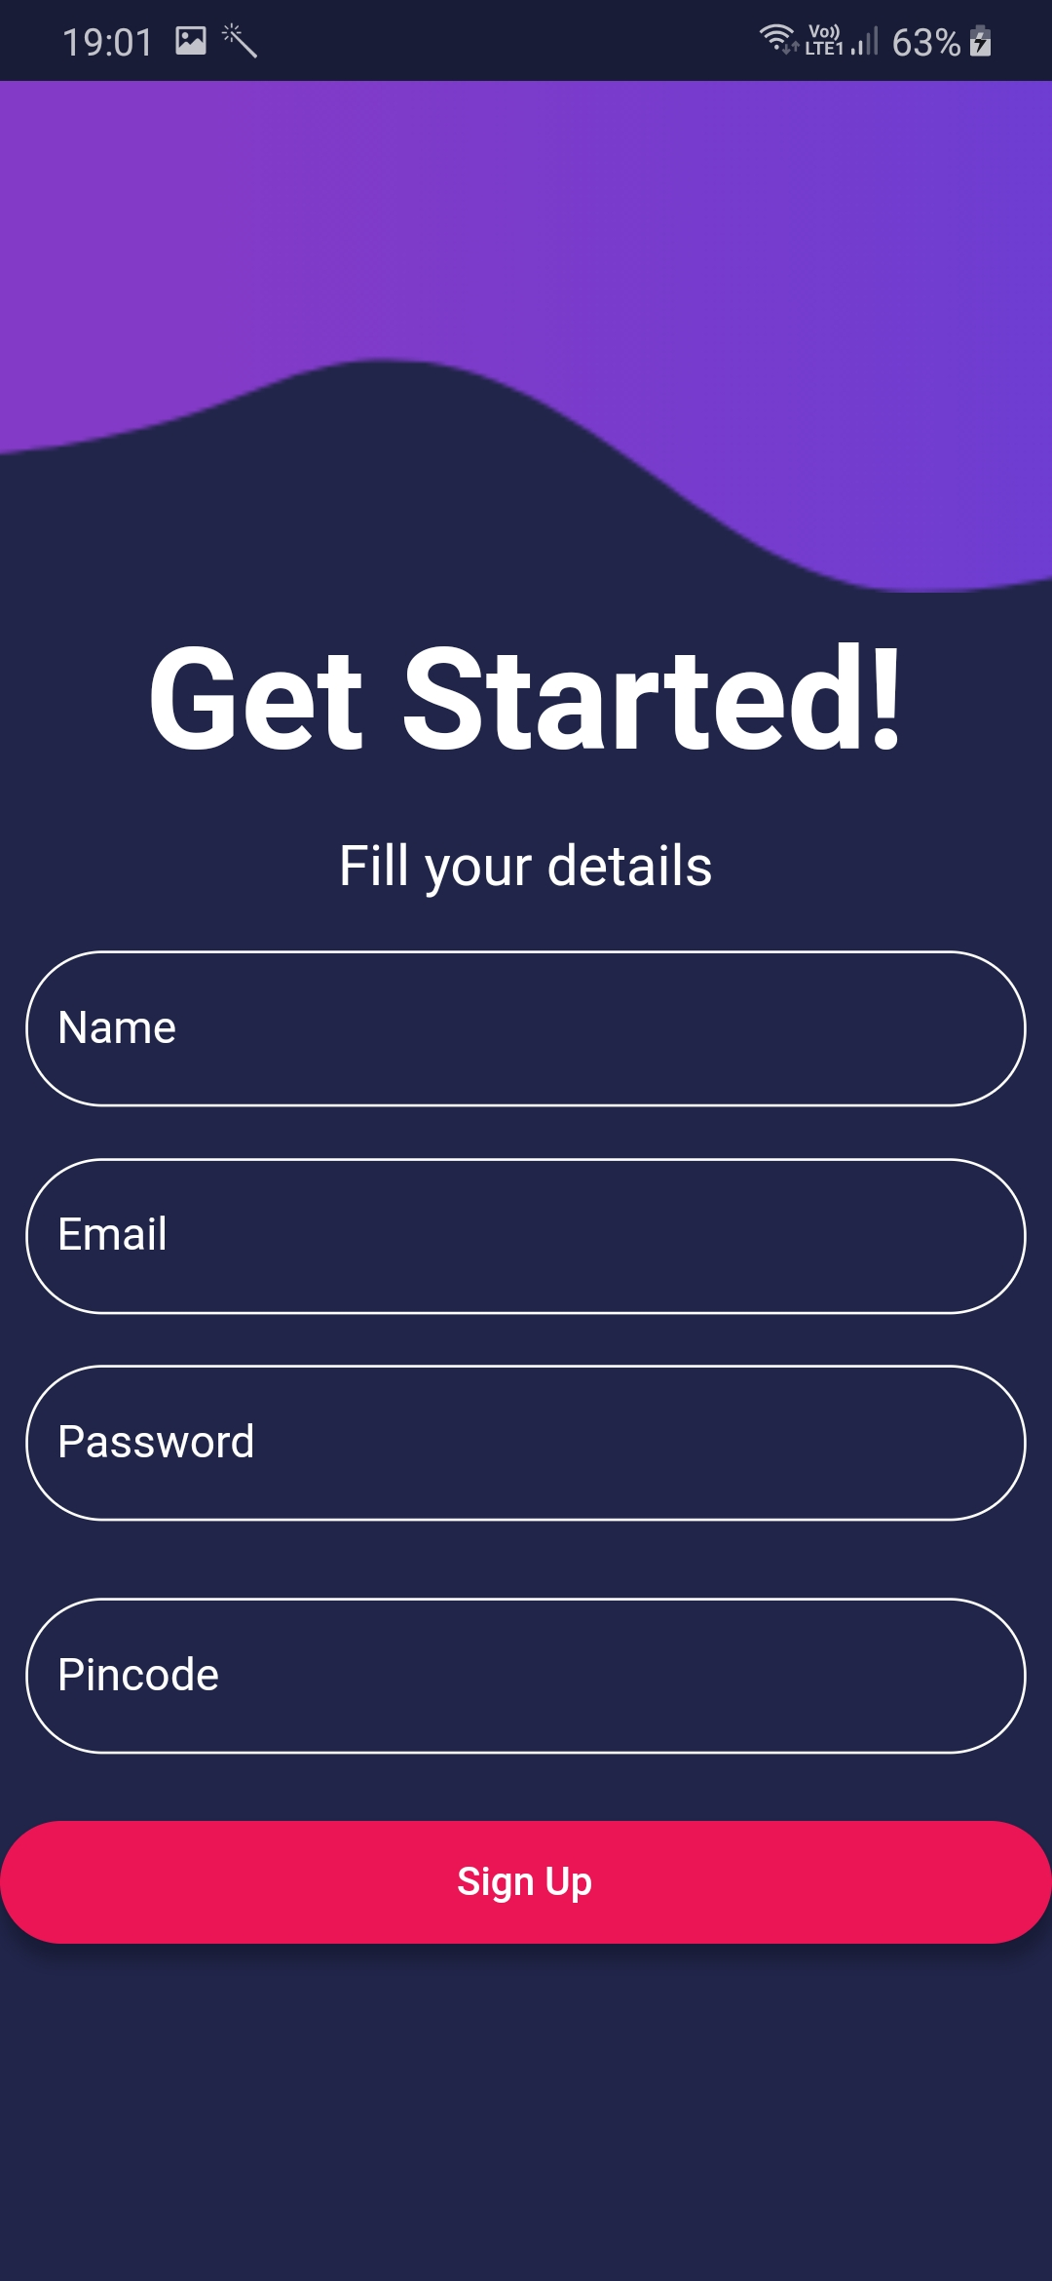
Customer Sign-Up
The customer can enter his details which are directly feeded to our database through this customer signup interface.

Slide 10
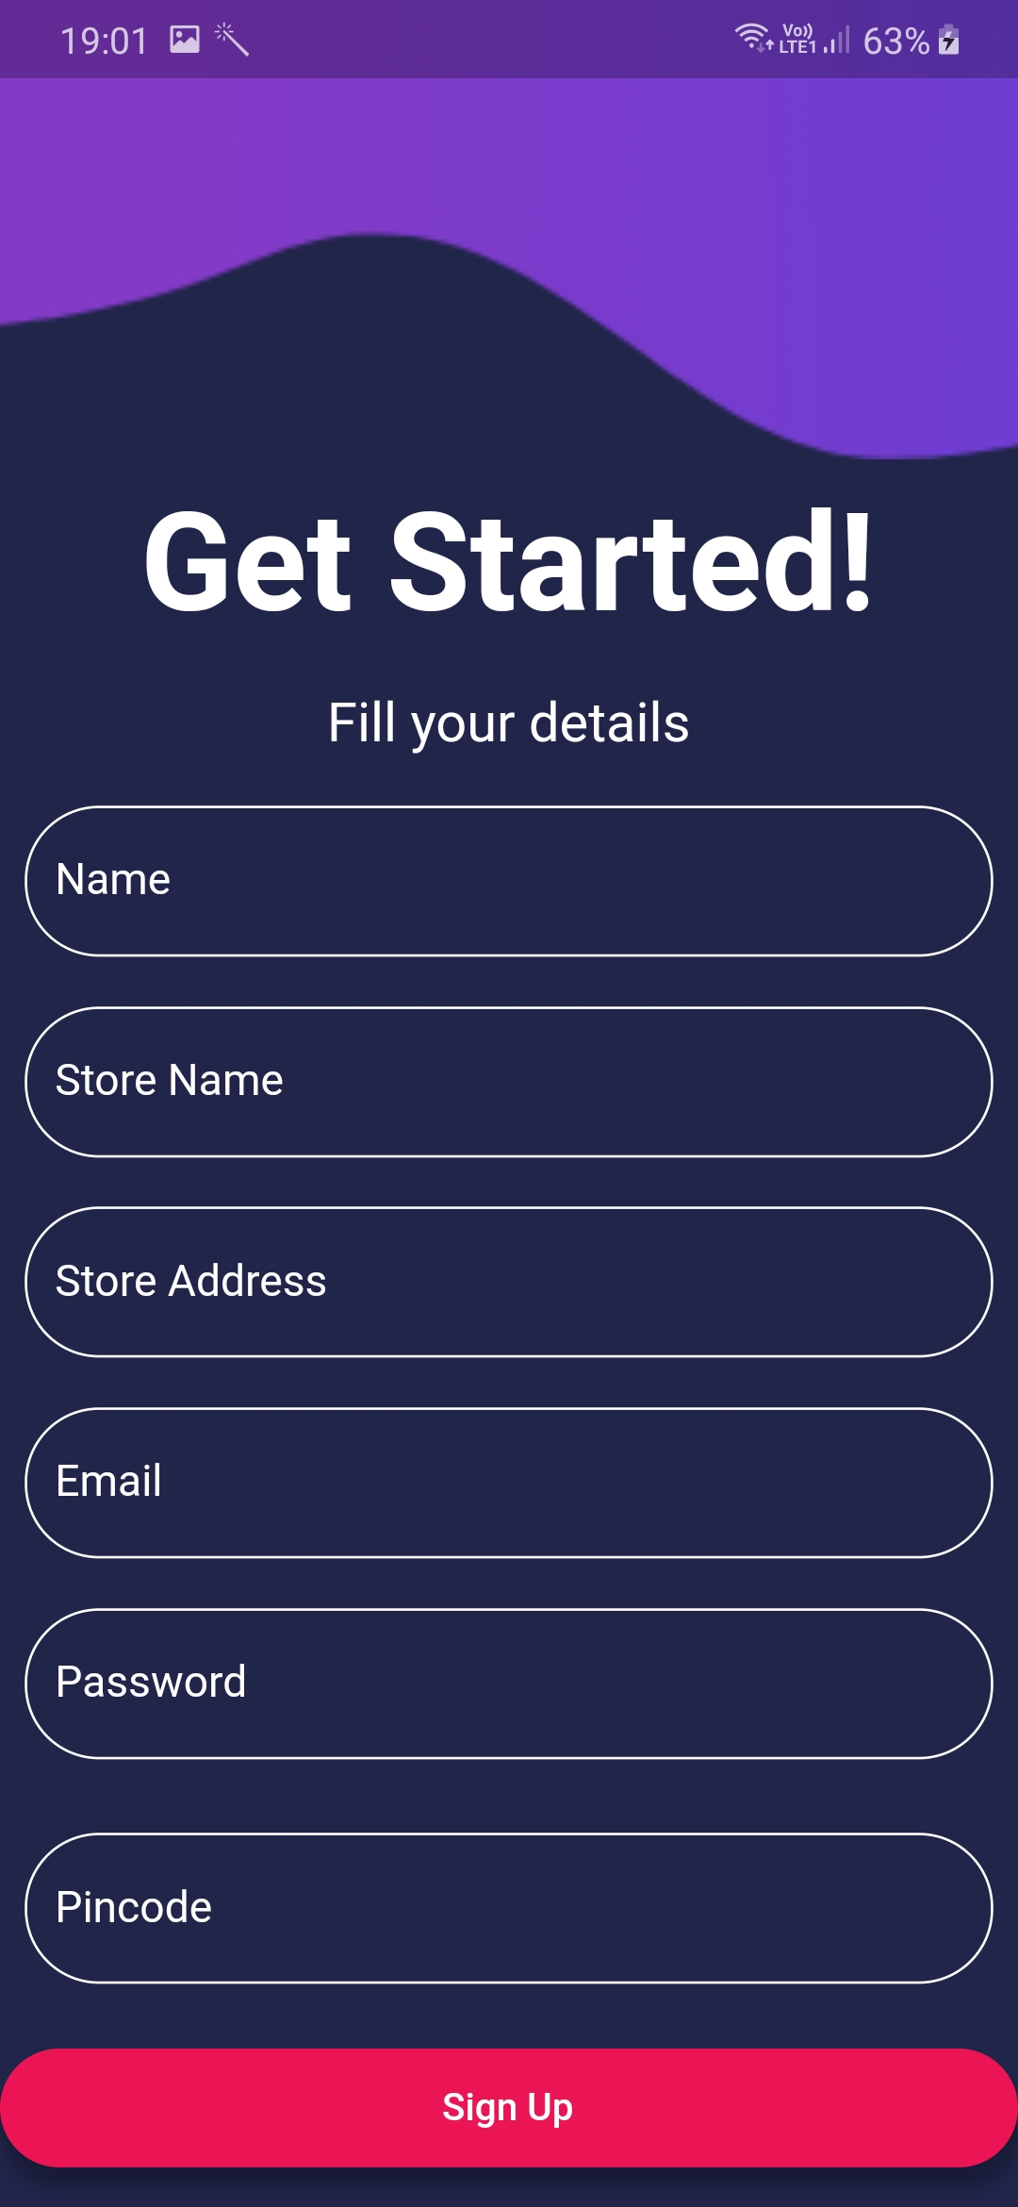
Shopkeeper Sign-Up
The shopkeeper can register his store and details to get enrolled in this project.

Slide 11
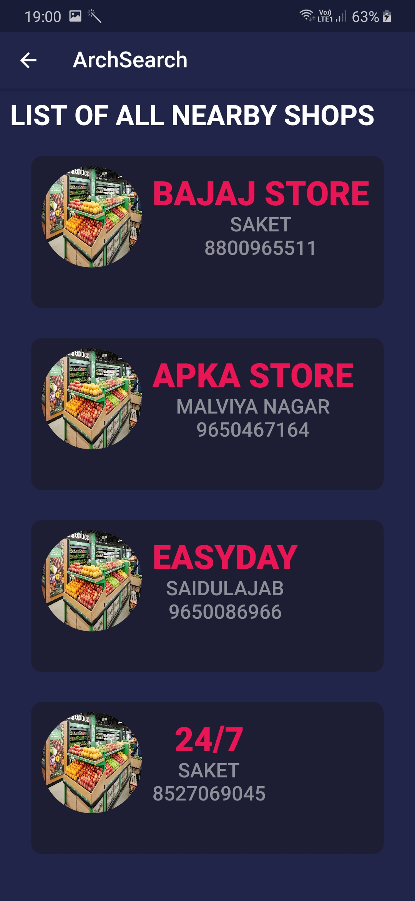
Customer Home
With this interface, the customer can view his nearby stores, filtered from his pincode, and select where he/she prefers to shop for utilities.

Slide 12
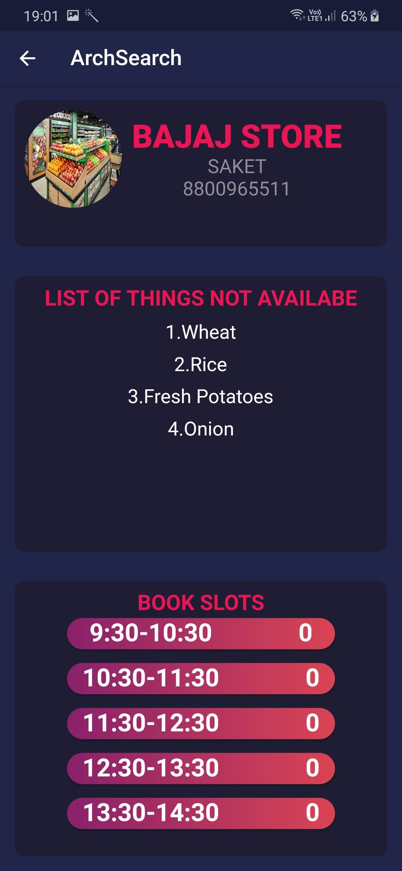
Store Info
The customer can view the store details, availability of wanted items, and book a slot as per his/her convenience.

Slide 13
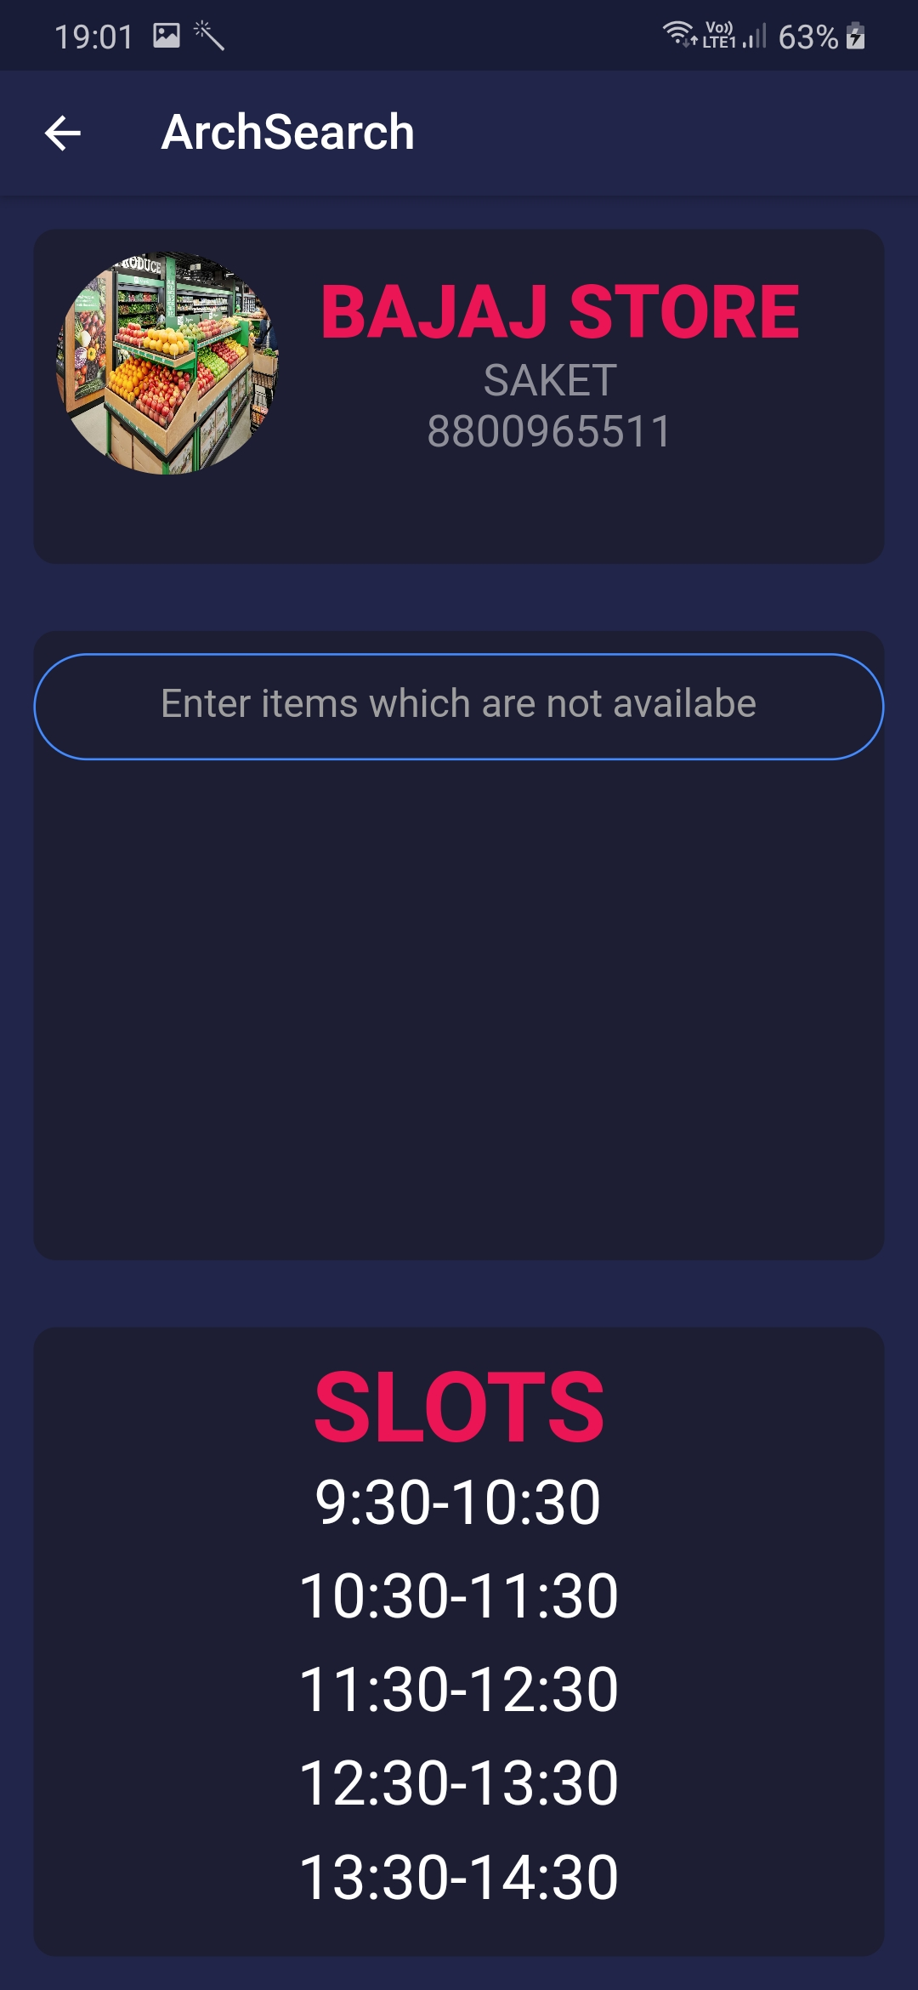
Shopkeeper Home
The shopkeeper can edit his list of unavailable items, and view the slots as well.

Slide 14

Thank you!
TEAM Shaktiman
Atharv Jairath - ADGITM
Bhavya Khandelwal - THAPAR
Ishaan Bajaj - THAPAR
Satwik Dudeja - DTU

